Slide 1


SMART INDIA HACKATHON 2026
TITLE PAGE
Problem Statement ID – SIH26055
Problem Statement Title- Smart Scan strategy for Electronic Warfare
Theme- Robotics and Drones
PS Category- Software
Team ID- SIH26-A0H-T359
Team Name – Half Squadron

Slide 2
IDEA TITLE
Half
Squadron
The Problem
Our Solution
Our Uniqueness
  Monitoring 0.5-18.0 GHz spectrum via 500 MHz IBW across 35 discrete channels against agile radars
  Literature ignores LO settling blind time (15-50 us), dropping pulses during hops
  Standard AI models suffer catastrophic forgetting under chaotic adversarial agility
  Dual-engine scan strategy dynamically allocates 500 MHz receiver dwells across 35 sub-bands
  Engine A (RL) predicts structured radar patterns to maximize intercept in 2-10 ms dwells
  Engine B (Adversarial Bandit) bounds worst-case regret to catch chaotic pseudo-random frequency hops
  Hysteresis dispatcher transitions between RL and AB without decision thrashing
  Hardware-aware loss directly penalizes LO slew latency (15 us + 2 us/GHz) in the control loop
  Threat-weighted utility prioritizes low-duty lethal missile locks over dense civil radar signals
  Edge-optimized design (<15k params) projected for sub-10 us inference on embedded FPGA SoCs
  Convex starvation barrier forces unvisited channel revisits before threat deadlines expire

Slide 3
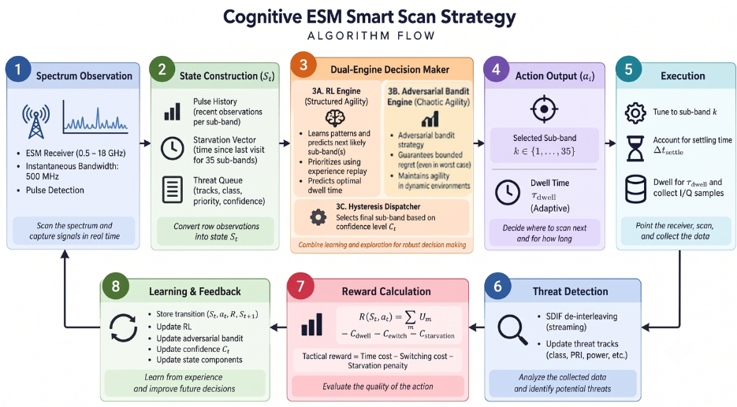
TECHNICAL APPROACH
Half
Squadron
Core Language: Python 3.12 (100% Native, Air-Gapped, Zero Cloud Dependencies)
Deep Reinforcement Learning: PyTorch
Adversarial Bandit Framework: NumPy & SciPy (Vectorized Adversarial Bandit Regret-Minimization Engine)
Environment & Simulation: Gymnasium (Discrete-Event RF Dwell & Blind-Time Simulation)
PDW Ingestion & Parsing: H5py & Pandas (TSRD 5D Radar Stream I/O)
De-Interleaving Algorithm: Streaming Sequential Difference Histogramming (SDIF Lineage)
Synthesizer Latency Models: Analog Devices ADF4371 & Texas Instruments LMX2594 PLL Specifications
Target Embedded Hardware: AMD/Xilinx Zynq UltraScale+ RFSoC / NVIDIA Jetson Orin Nano

Slide 4
FEASIBILITY AND VIABILITY
Half
Squadron
Analysis of Feasibility​ | Potential Challenges & Risks​ | Mitigation Strategies​
Low Compute & Memory ​ Compact model suitable for low-power edge platforms.​ | Adversarial Non-Stationarity ​ Changing environments can reduce the performance of fixed policies.​ | Dual-Engine EXP3 Fallback ​ Uses an adaptive fallback strategy under changing conditions.​
Real-Time Decision Making ​ Low inference latency enables rapid processing of incoming signals.​ | Reward Imbalance ​ Frequent signals may dominate the learning process.​ | Priority-Aware Reward ​ Weights observations based on mission-defined priority rather than pulse count alone.​
Realistic Signal Synthesis ​ Signal parameters are derived from ADF4371 and LMX2594 datasheet specifications.​ | Incomplete Ground Truth ​ Operational data may be noisy, incomplete, or unlabeled.​ | Streaming SDIF De-Interleaving ​ Separates overlapping signal streams through online sequential processing.​
Native Edge Execution ​ Designed for deployment without dependence on external cloud services.​ | Engine Mode Switching ​ Frequent switching between algorithms can introduce processing overhead.​ | Hysteresis Confidence Filter ​ Uses dual confidence thresholds to prevent rapid mode switching.​

Slide 5
IMPACT AND BENEFITS
Half
Squadron
Potential Impact on the Target Audience
Directly improves survivability for aircrew and ship crews operating under RWR/ESM cover — faster, more reliable threat detection in the critical seconds before missile lock
Reduces cognitive load on human operators by automating scan prioritization, letting crews focus on tactical response rather than manual threat triage
Strengthens India's indigenous EW capability, reducing reliance on imported ESM receiver systems for frontline defense platforms
Applicable across multiple platform classes (airborne, naval) without redesign, since the controller is software-defined on top of standard receiver hardware
Social
Economic
Environmental / Operational Efficiency
  Builds domestic expertise in cognitive EW systems, contributing to India's defense R&D talent base
  Protects military personnel by closing the detection gap against modern agile-hopping threat radars
  Lowers dependency on costly foreign-sourced ESM technology, supporting indigenous defense manufacturing (Atmanirbhar Bharat in defense electronics)
  Software-defined intelligence layered on existing hardware reduces the need for expensive receiver redesigns or additional RF front-end hardware
  SWaP-C-aware design (Size, Weight, Power, Cost) avoids the extra power draw and thermal load of full-spectrum simultaneous digitization
  Efficient sub-band scanning reduces unnecessary continuous wideband processing, lowering onboard power consumption during extended patrol/mission durations

Slide 6
RESEARCH AND REFERENCES
Half
Squadron
Radar Dataset Turing Synthetic Radar Dataset (TSRD) — https://arxiv.org/abs/2602.03856 Dataset repository — https://huggingface.co/datasets/alan-turing-institute/turing-synthetic-radar-dataset
De-Interleaving Foundations
  Davies & Hollands (1982), "Automatic processing for ESM" — https://doi.org/10.1049/ip-f-1.1982.0025
  Mardia (1989), "New techniques for the deinterleaving of repetitive sequences" https://doi.org/10.1049/ip-f-2.1989.0025
  Milojević & Popović (1992), "Improved algorithm for the deinterleaving of radar pulses" https://doi.org/10.1049/ip-f-2.1992.0012
Cognitive Algorithms
  Mnih et al. (2015), "Human-level control through deep reinforcement learning" https://doi.org/10.1038/nature14236
  Schaul et al. (2016), "Prioritized Experience Replay" — https://arxiv.org/abs/1511.05952
  Auer et al. (2002), "The Nonstochastic Multiarmed Bandit Problem" https://doi.org/10.1137/S0097539701398375
Synthesizer Hardware Baselines
  Analog Devices, ADF4371 Datasheet https://www.analog.com/media/en/technical-documentation/data-sheets/adf4371.pdf
  Texas Instruments, LMX2594 Datasheet — https://www.ti.com/lit/ds/symlink/lmx2594.pdf

